Slide 1

物聯網平台設計 Final Project Proposal Smart Hand Gesture Power Appliance
National Chiao Tung Univ. 蔡一嘉 Richard Yi-Chia Tsai 劉長諺 Curtis Chuang-Yan Liu

Slide 2
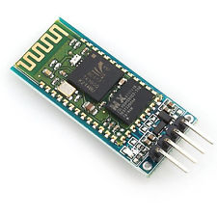

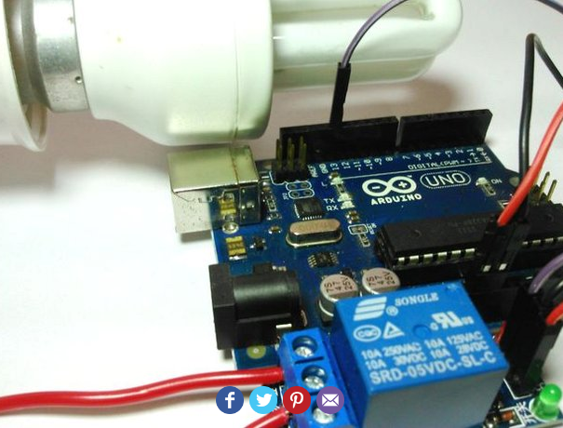
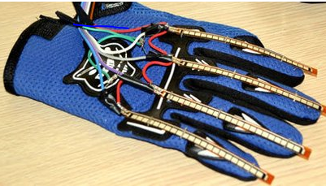
Smart Hand Gesture Power Appliance
Infrastructure
Flex (bend) sensors which are equipped on gloves
Detect bend sensing trigger signal
Wireless signal communication between two bluetooths
Realize the achievement of controlling Smart Home remotely
Notes:
With the emerging IoT development, it is more likely that the imaginary scene of manipulating your household appliances remotely seen in Sci Fi film will be fulfilled in the near future. In this case, we design and implement Arduino as well as its a variety of sensor components to demonstrate how to control our household appliances remotely.
In our infrastructure, we make use of flex (bend) sensors which are equipped on gloves to proceeding bend sensing. Thereby, when user bends his finger with certain pattern, the Arduino can detect the specific trigger caused by corresponding bending pattern of finger and then generate the signal to transmit to relay part via Bluetooth so that we can control our household appliances with wireless method as expected.

Slide 3
Smart Hand Gesture Power Appliance
Hardware:
2 * Arduino Yun
1 * Relay module with 2 poles
2 * Flex (Bend) Sensor
2 * Bluetooth HC06
Household appliances such bulb, adapter for iPhone.
LEDs, Servo, Speaker
Software:
Arduino Sketch Code
Bluetooth AT Command
Gloves

